Slide 1

Unmarked MATLAB Exercise
Module 3
Miss Yijia Hao, Dr Fengsheng Wei
James Watt School of Engineering

Slide 2
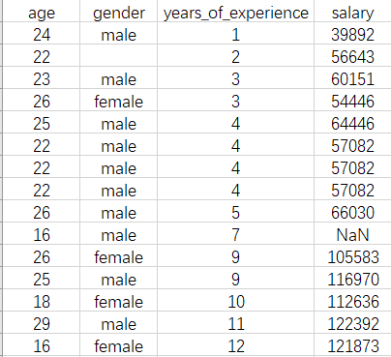
Exercise
The salary dataset consists of the following columns:
age
gender
years_of_experience
salary
The raw dataset is stored in a CSV file (see reading materials), but it has the following issues:
There are repeated rows.
Some entries are missing gender information.
Some salary entries are recorded as NaN.
Certain participants recorded their years of experience using a scale above 5, whereas the required scale is between 1 and 5.

Slide 3
Exercise
Write a MATLAB script to clean this data. After executing the script, the cleaned data should meet the following criteria:
  Duplicate rows are removed.
  Missing gender information is filled with 'male'.
  NaN salary values are replaced with the average salary of the other participants.
  Years of experience values exceeding 5 are capped at 5.
  The mean and standard deviation of the salary according to years of experience (1-5) are calculated.

Slide 4
Exercise Reference Solution
Read the table and remove duplicate rows:
T = readtable("salary_uncleaned.csv");
T2 = unique(T);
Find the index of NaN values in the salary column:
nan_idx = find(isnan(T2.salary));

Slide 5
Exercise Reference Solution
Set the NaN values to 0, thus we can calculate the mean salary of other participants:
for i = nan_idx
T2.salary(i) = 0;
end
mu = sum(T2.salary)/(length(T2.salary) - length(nan_idx));
Set the NaN values to the mean salary of other participants:
for i = nan_idx
T2.salary(i) = mu;
end

Slide 6
Exercise Reference Solution
Set the gender to “male” if it is absent
for i = 1:length(T2.gender)
if T2.gender{i} == ""
T2.gender{i} = "male";
end
Set the years_of_experience to 5 if it is larger than 5:
for i = 1:length(T2.years_of_experience)
if T2.years_of_experience(i) > 5
T2.years_of_experience(i) = 5;
end
end

Slide 7
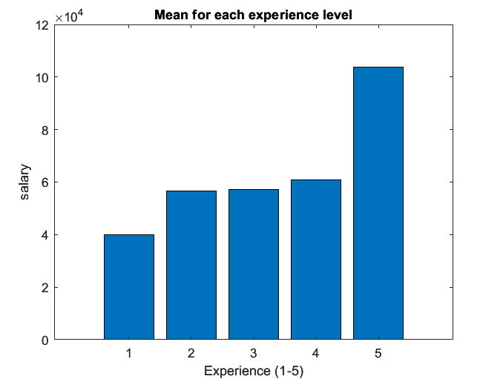
Exercise Reference Solution
Calculate the mean and standard deviation of the salary:
for i = 1:5
means(i) = mean(T2.salary(T2.years_of_experience==i));
std_devs(i) = std(T2.salary(T2.years_of_experience==i));
end
Bar plotting:
bar(means)
title("Mean for each experience level")
ylabel("salary")
xlabel("Experience (1-5)")

Slide 8




Thanks!
#UofGWorldChangers
@UofGlasgow

